Slide 1
목차
개요
개발일정
Driver구성 및 비교
배경지식
구현 원리
시연
SOURCE 분석
참고자료
질문답변
평가

Slide 2
개요
HID Device 의 이해
USB interrupt pipe 활용 실습
Pointer input device 구현
Windows power 정책의 이해

Slide 3
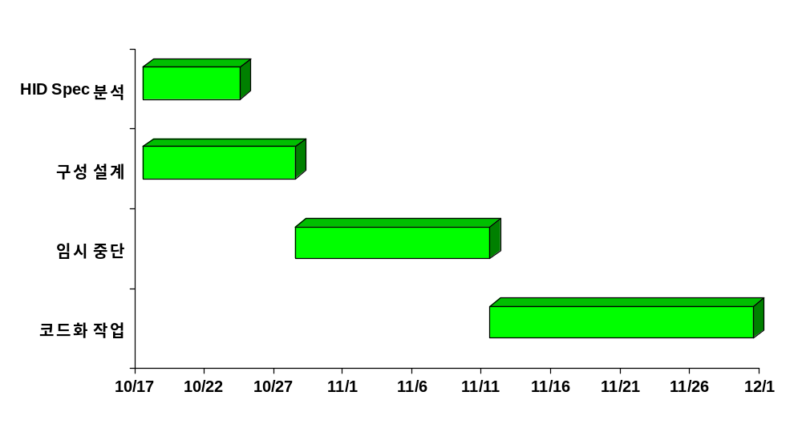
개발일정

Slide 4
Driver 구성(HID driver stack)
USER32.EXE or USER.EXE
User mode
Kernel mode
Mouse class driver
Mouse HID mapper driver
IRP Interface
hidparse.sys
HID class driver
IRP and Callback Interface
USB HID
minidriver
USB driver
stack
USB bus
HW

Slide 5
Driver 구성(Hajemouse driver stack)
USER32.EXE or USER.EXE
User mode
Kernel mode
Mouse class driver
USB port Hajemouse
(hjmouse.sys)
USB driver
stack
USB bus
HW

Slide 6
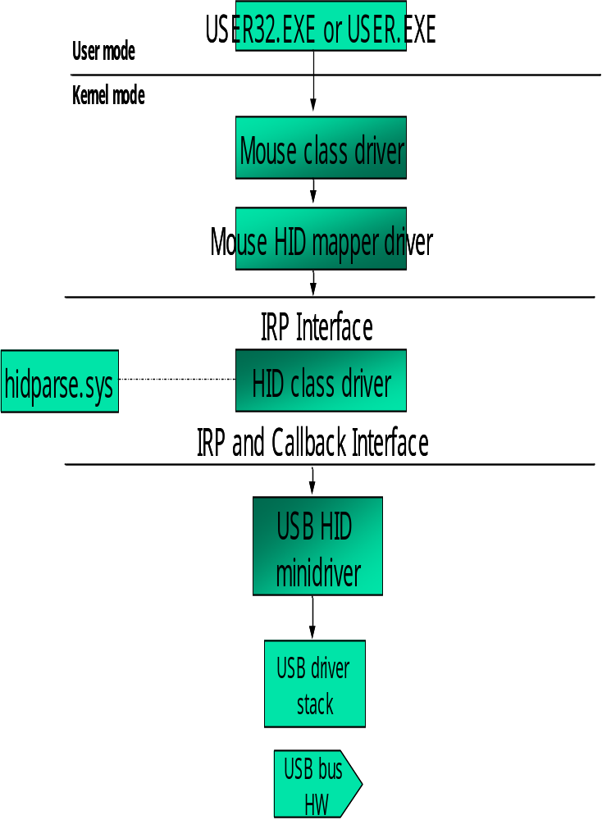
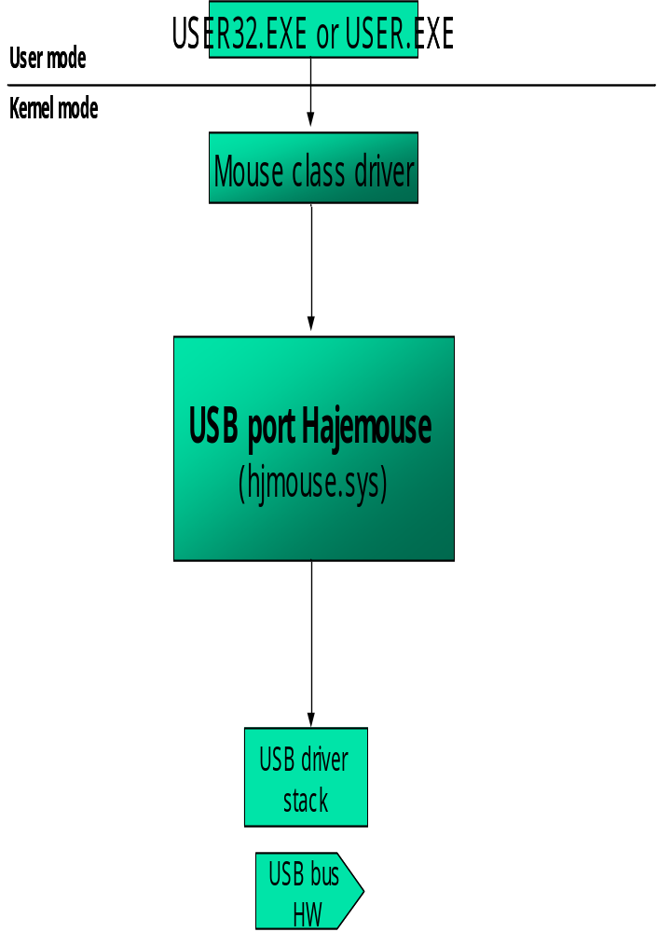
Drivers 비교

Slide 7
배경지식(Type of polling-1)
Completion polling
  StartPolling()
  {
  …..
  IoAllocateIrp()
  UsbBuildInterruptOrBulkTransferRequest()
  IRP<-URB
  IoSetCompletionRoutine()
  IoCallDriver()
  ……
  }
  CompletionRoutine()
  {
  …….
  IRP<-URB
  IoSetCompletionRoutine()
  IoCallDriver()
  Return STATUS_MORE_PROCESSING_REQUIRED
  }

Slide 8
배경지식(Type of polling-2)
Timer
SetStartTimer()
{
…..
KeInitializeDpc()
KeInitializeTimer()
KeSetTimerEx()
……
}
DpcTimerRoutine()
{
…….
(*(PSERVICE_CALLBACK_ROUTINE) DeviceExtension->ConnectData.ClassService)(
DeviceExtension->ConnectData.ClassDeviceObject,
StartInput,
EndInput,
&inputDataConsumed
);
…….
}

Slide 9
배경지식(Type of polling-3)
System thread
StartThreadRoutine()
{
PsCreateSystemThread()
ObReferenceObjectByHandle()
ZwClose()
}
EndThreadRoutine()
{
KeSetEvent()
KeWaitForSingleObject()
ObDereferenceObject()
}

Slide 10
배경지식(Type of polling-4)
System thread
ThreadRouine()
{
……..
while(TRUE)
{
ntStatus = KeWaitForSingleObject( , , , FALSE , &Deutime);
if(ntStatus == STATUS_SUCCESS)
PsTerminateSystemThread(STATUS_SUCCESS);
    ….…..
    IRP<-URB
    ntStatus = IoCallDriver( )
if(ntStatus == STATUS_PENDING)
KeWaitForSingleObject();
(*(PSERVICE_CALLBACK_ROUTINE) mouseclasscallbackservice
……….
If(종료조건)
PsTerminateSystemThread(STATUS_SUCCESS);
}
}

Slide 11

배경지식(HID Specification)
Device Descriptor
Configuration Descriptor
Interface Descriptor
HID Descriptor
Report Descriptor
Physical Descriptor
Endpoint Descriptor

Slide 12
배경지식(HID Specification-1)
HID Descriptor structure
typedef struct _HID_DESCRIPTOR
{
UCHAR bLength;
UCHAR bDescriptorType;
USHORT bcdHID;
UCHAR bCountry;
UCHAR bNumDescriptors;
struct _HID_DESCRIPTOR_DESC_LIST {
UCHAR bReportType;
USHORT wReportLength;
} DescriptorList [1];
} HID_DESCRIPTOR, *PHID_DESCRIPTOR;
bLength, bDescriptorType : Common Descriptor구조로 Descriptor 자신을 표현한다.
bcdHID : HID release No.
bCountry : 지역Code
bNumDescriptors : 하위 Descriptor의 수를 나타낸다.
bReportType : Descriptor list에 Report type을 나타낸다.
wReportLength : Report Descriptor의 길이

Slide 13
배경지식(HID Specification-2)
HID Report Descriptor
  Global, Main, Local 3종류의 Items
  Short Item 과 Long Item Formats
  Items를 분석 함으로 HID Device와 주고 받는 Raw data format의 Reports 의미를 파악할 수 있다.

Slide 14


배경지식(HID Specification-3)
Application
Collection
Collection
Report
Report
Report
Main Item
Main Item
Report size
Report Count
Logical Minimum
Logical Maximum
Main Item
Report Size
Report Count
Logical Minimum
Logical Maximum
Usage
Usage
Usage
Usage
Usage
Usage

Slide 15
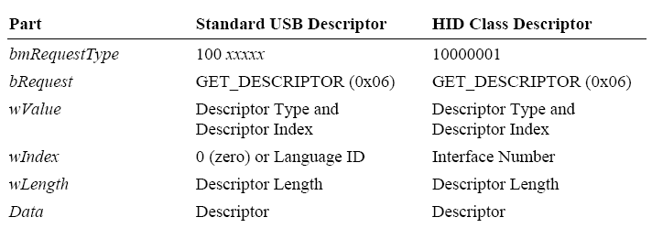
배경지식(HID Specification-4)
HID Requests

Slide 16
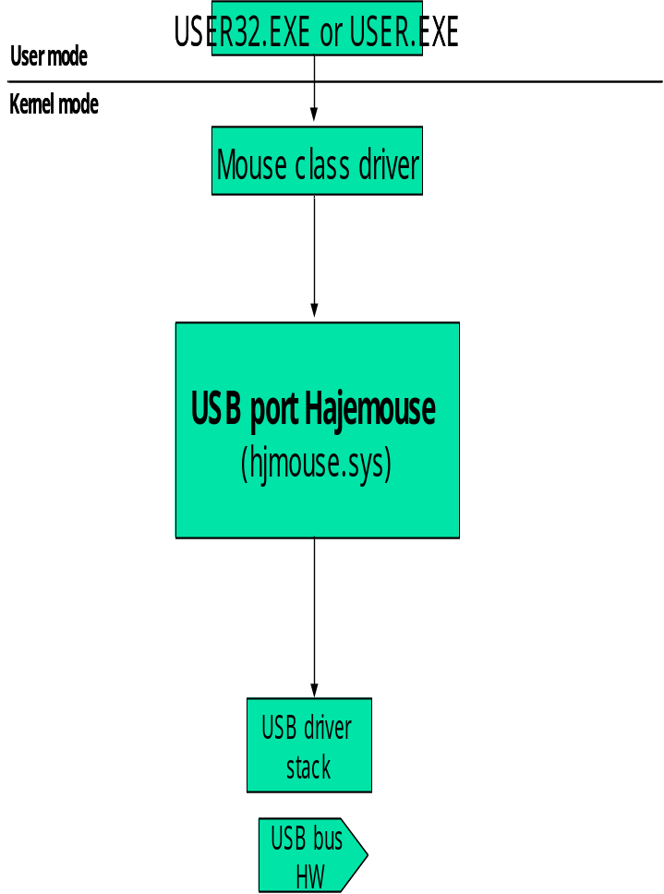
구현원리(IRP 및 DATA 흐름도)
FiDOdev
Mouse class service callback
System thread
FDOdev
My IRP flowing
Read IRP flowing
Call back
PDOdev
MOUSE INPUT DATA
Raw data

Slide 17
설치방법 및 기능 동작
Windows\inf\input.inf 폴더에서 제거(자동설치를 막기 위해 임시 제거)
HjMouse.inf로 HjMouse.sys 설치
마우스 기능 동작
대기 모드 TEST

Slide 18
참고자료
DDK documentation.
Device class definition for HID. Ver 1.11
HID Usage Tables. Ver 1.12
www.hajesoft.co.kr (Power 예제)
www.mgeups.com/opensource/projects/hidparser.htm

